Slide 1
Energy Conservation Strategies for eSC
Prof. C. Dunham, J. Reilly
Group 6: Saman Langari , Aakanksha Sonawane, Wan-Hsin Hu, Sakshi Shinde

Slide 2
Contents
Introduction | Brief overview of the project and its importance to eSC
Data Sets Used | Number of records in dataset evaluated
Predicting Future Energy Usage/ Key Drivers of Energy Usage | Results of the prediction model
 | Analysis of key factors influencing energy usage
Actionable Insights | Specific strategies and recommendations for eSC to reduce energy costs
Conclusion | Summary of key findings and recommendations
Q&A | Questions

Slide 3
Introduction
The Challenge:
Increasing temperatures and global warming trends pose a significant challenge to energy grids.
July's peak energy demand raises concerns for potential system strain and blackouts.
Our Objective:
To understand the primary factors driving energy consumption.
To encourage energy-saving measures among customers, reducing the need for additional infrastructure.

Slide 4
Data Sets Used
Meta Data
Static House Data
A data description file that
describes the fields used in
the various housing data files.
Contains data on about 5,000 single-family homes that use eSC energy.
Energy Usage Data
Weather Data
Provides hourly energy
consumption statistics
for each residence in the
Static residence Data.
Hourly weather data,
with one file for each
geographic area (county).

Slide 5
4,000,000+ obs. Of 100+ variables
• Number of records in dataset evaluated

Slide 6
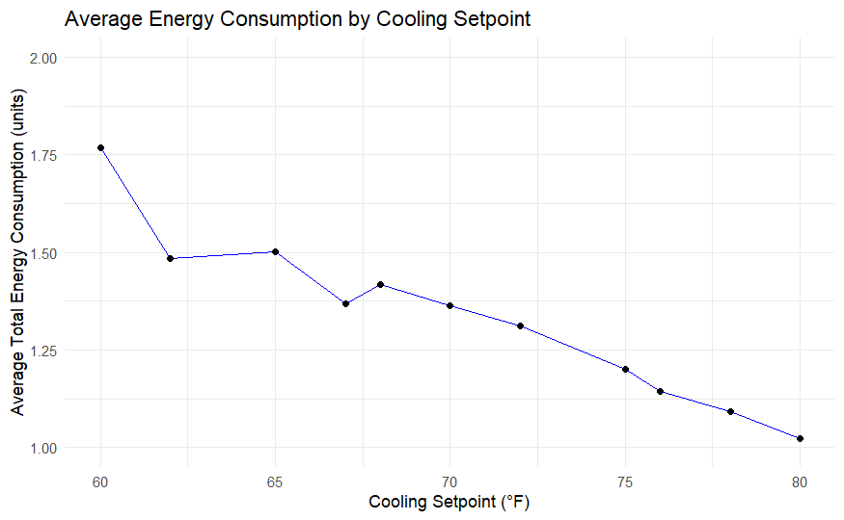
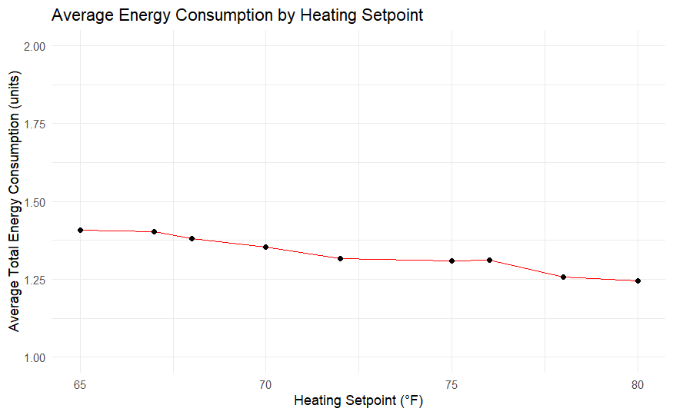
Energy Consumption By Setpoint
Notes:
Optimal Setpoint Range: Recommend a setpoint range that balances energy efficiency with occupant comfort. While higher setpoints save energy, they must also be acceptable to the building occupants.
Educate Consumers: Inform customers that they can achieve significant energy savings by increasing their cooling setpoints, especially if they are currently setting their thermostats lower than 65°F.
Promote Programmable Thermostats: Encourage the use of programmable or smart thermostats that can automatically adjust the setpoint to higher temperatures during times of low occupancy or during peak demand hours to save energy.
Maintenance and Upgrades: Suggest regular HVAC maintenance and potential system upgrades to ensure that energy is not wasted due to inefficiencies, which can complement the setpoint adjustments.

Slide 7
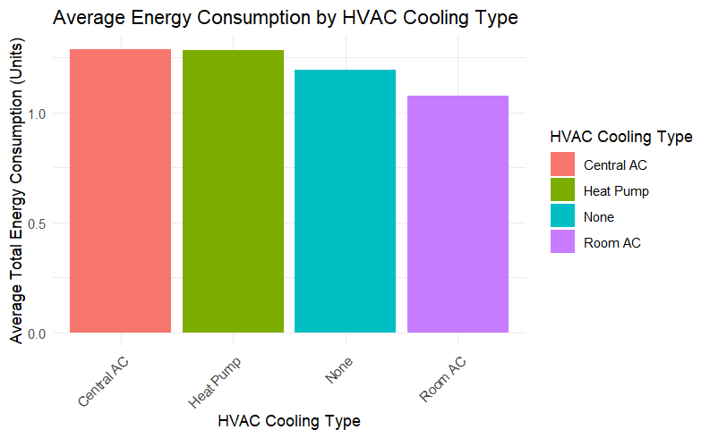
HVAC Cooling Type
Notes:
Energy Consumption Peaks: There seems to be an increase in average energy consumption across all cooling types during the late afternoon and evening hours (likely from 15:00 to 23:00). This could correspond to increased occupancy and activity during these hours, or to the outside temperature being at its highest, thus requiring more cooling.
Optimize Cooling Schedules: Recommend that customers with programmable thermostats or building management systems adjust their cooling schedules. This might include increasing the setpoint during off-peak hours or when buildings are unoccupied, and pre-cooling spaces during hours when energy consumption is typically lower.
Efficient Cooling Systems: It appears that certain cooling types, such as 'Central AC' and 'Heat Pump,' might be more efficient at certain hours, as indicated by the lower average energy consumption. Encourage customers to invest in these more efficient systems, especially in locations where the cooling demand is high.
Maintenance and Upgrades: Advise customers on the importance of regular HVAC maintenance. Clean and well-maintained systems operate more efficiently and can contribute to lower energy consumption during peak hours.
Demand Response Programs: Implement or expand demand response programs that incentivize customers to reduce or shift their energy usage during peak hours. This could help flatten the peak demand curve seen in the late afternoon and evening.
Alternative Cooling Methods: For periods when 'Room AC' or 'None' (which could indicate natural ventilation or no active cooling) show higher energy consumption, suggest alternative cooling strategies. These could include using fans, shading, or passive cooling techniques that might be more energy-efficient.
Tailored Solutions: Develop customized energy-saving solutions based on HVAC system types. Different systems may have unique efficiencies and operational strategies that could be optimized.
Education on Peak Demand Impact: Educate customers about how their energy usage during peak hours can affect not only their energy costs but also the overall strain on the energy grid.
Energy-Efficient Building Design: Promote energy-efficient building design and retrofits that reduce the need for mechanical cooling, such as better insulation, reflective roofing, or strategic window placement.
Incentivize Off-Peak Usage: Offer special pricing or incentives for energy usage during off-peak hours to encourage shifting energy-intensive activities.

Slide 8
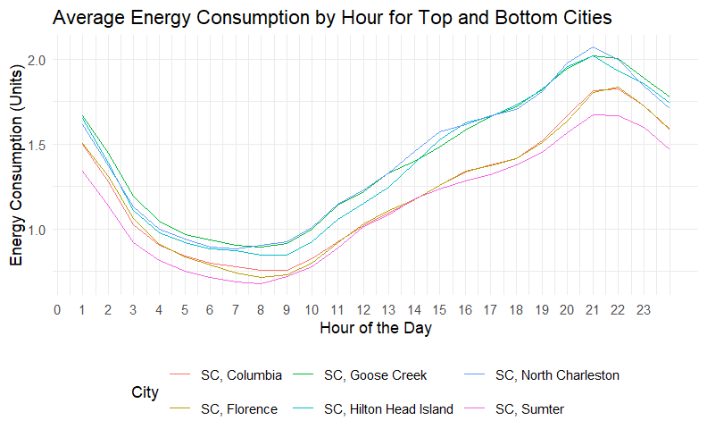
Peak Energy by Region and Hour (Top &Bottom)
Notes:
Identify Peak Hours: Energy demand peaks in the late afternoon and evening across all regions, roughly from 15:00 to 21:00. This information can be used to implement demand response initiatives.
Regional Demand Response: Some regions, presumably with thicker lines indicating higher energy demand, could be targeted more aggressively with demand response programs, especially during peak hours.
Load Shifting: Encourage customers, particularly in regions with the highest peaks, to shift their energy usage to off-peak hours. This could be through time-of-use pricing or other incentives.
Energy Efficiency Programs: Regions that consistently show higher energy demand might benefit from energy efficiency upgrades, such as LED lighting, energy-efficient appliances, or improved insulation.
Differential Pricing: Implement or suggest differential pricing strategies for peak and off-peak hours to incentivize reduced consumption during peak times.
Customized Energy Solutions: Offer tailored energy solutions for each region based on their specific demand patterns. For instance, regions with early peaks might benefit from solar energy solutions that capitalize on daytime generation.
Invest in Infrastructure: For regions with sustained high demand, consider investing in infrastructure upgrades to handle peak loads more efficiently.
Community Engagement: Engage with communities in regions with high peak demand to educate about peak energy usage and its impact on the grid and environment.
Renewable Energy Integration: Promote and facilitate the integration of renewable energy sources, such as solar panels, which can help reduce the strain on the grid during peak hours when sunlight is still available.
Monitoring and Adjustments: Continuously monitor the impact of implemented strategies and be ready to make adjustments as necessary. Energy consumption patterns can change due to various factors, including weather patterns and economic activities.

Slide 9
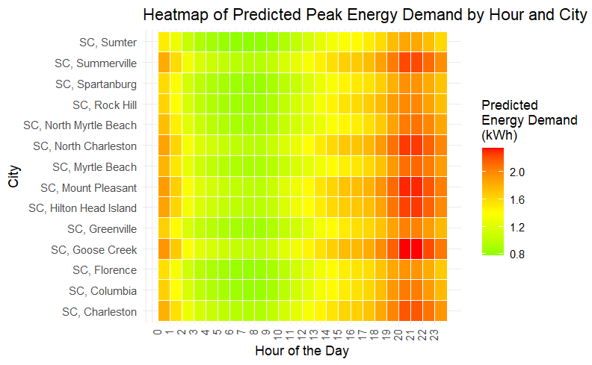
Heatmap of Predicted Peak Energy
You can enter a subtitle here if you need it
Notes:
Demand Management: Implement demand management strategies in regions with consistently high energy demand, especially during peak hours. This could involve shifting non-essential energy use to off-peak hours through incentives or adjusting pricing during peak periods to encourage conservation.
Energy Efficiency Focus: Target energy efficiency improvements in areas that show the highest peak demand. This might include upgrading to more efficient HVAC systems, improving insulation, and installing energy-efficient lighting.
Load Balancing: Encourage load balancing across different regions by promoting energy use at different times of the day where possible. For example, regions with lower nighttime demand could be targeted for activities that could be shifted from peak times.
Infrastructure Upgrades: Assess the need for infrastructure upgrades in regions with the highest peaks to ensure reliability and capacity to handle peak loads without outages.
Customized Solutions: Each region likely has unique factors contributing to its energy demand profile. Tailor solutions to the specific needs and characteristics of each region. For instance, regions with late-night peaks might benefit from different strategies compared to regions with afternoon peaks.

Slide 10
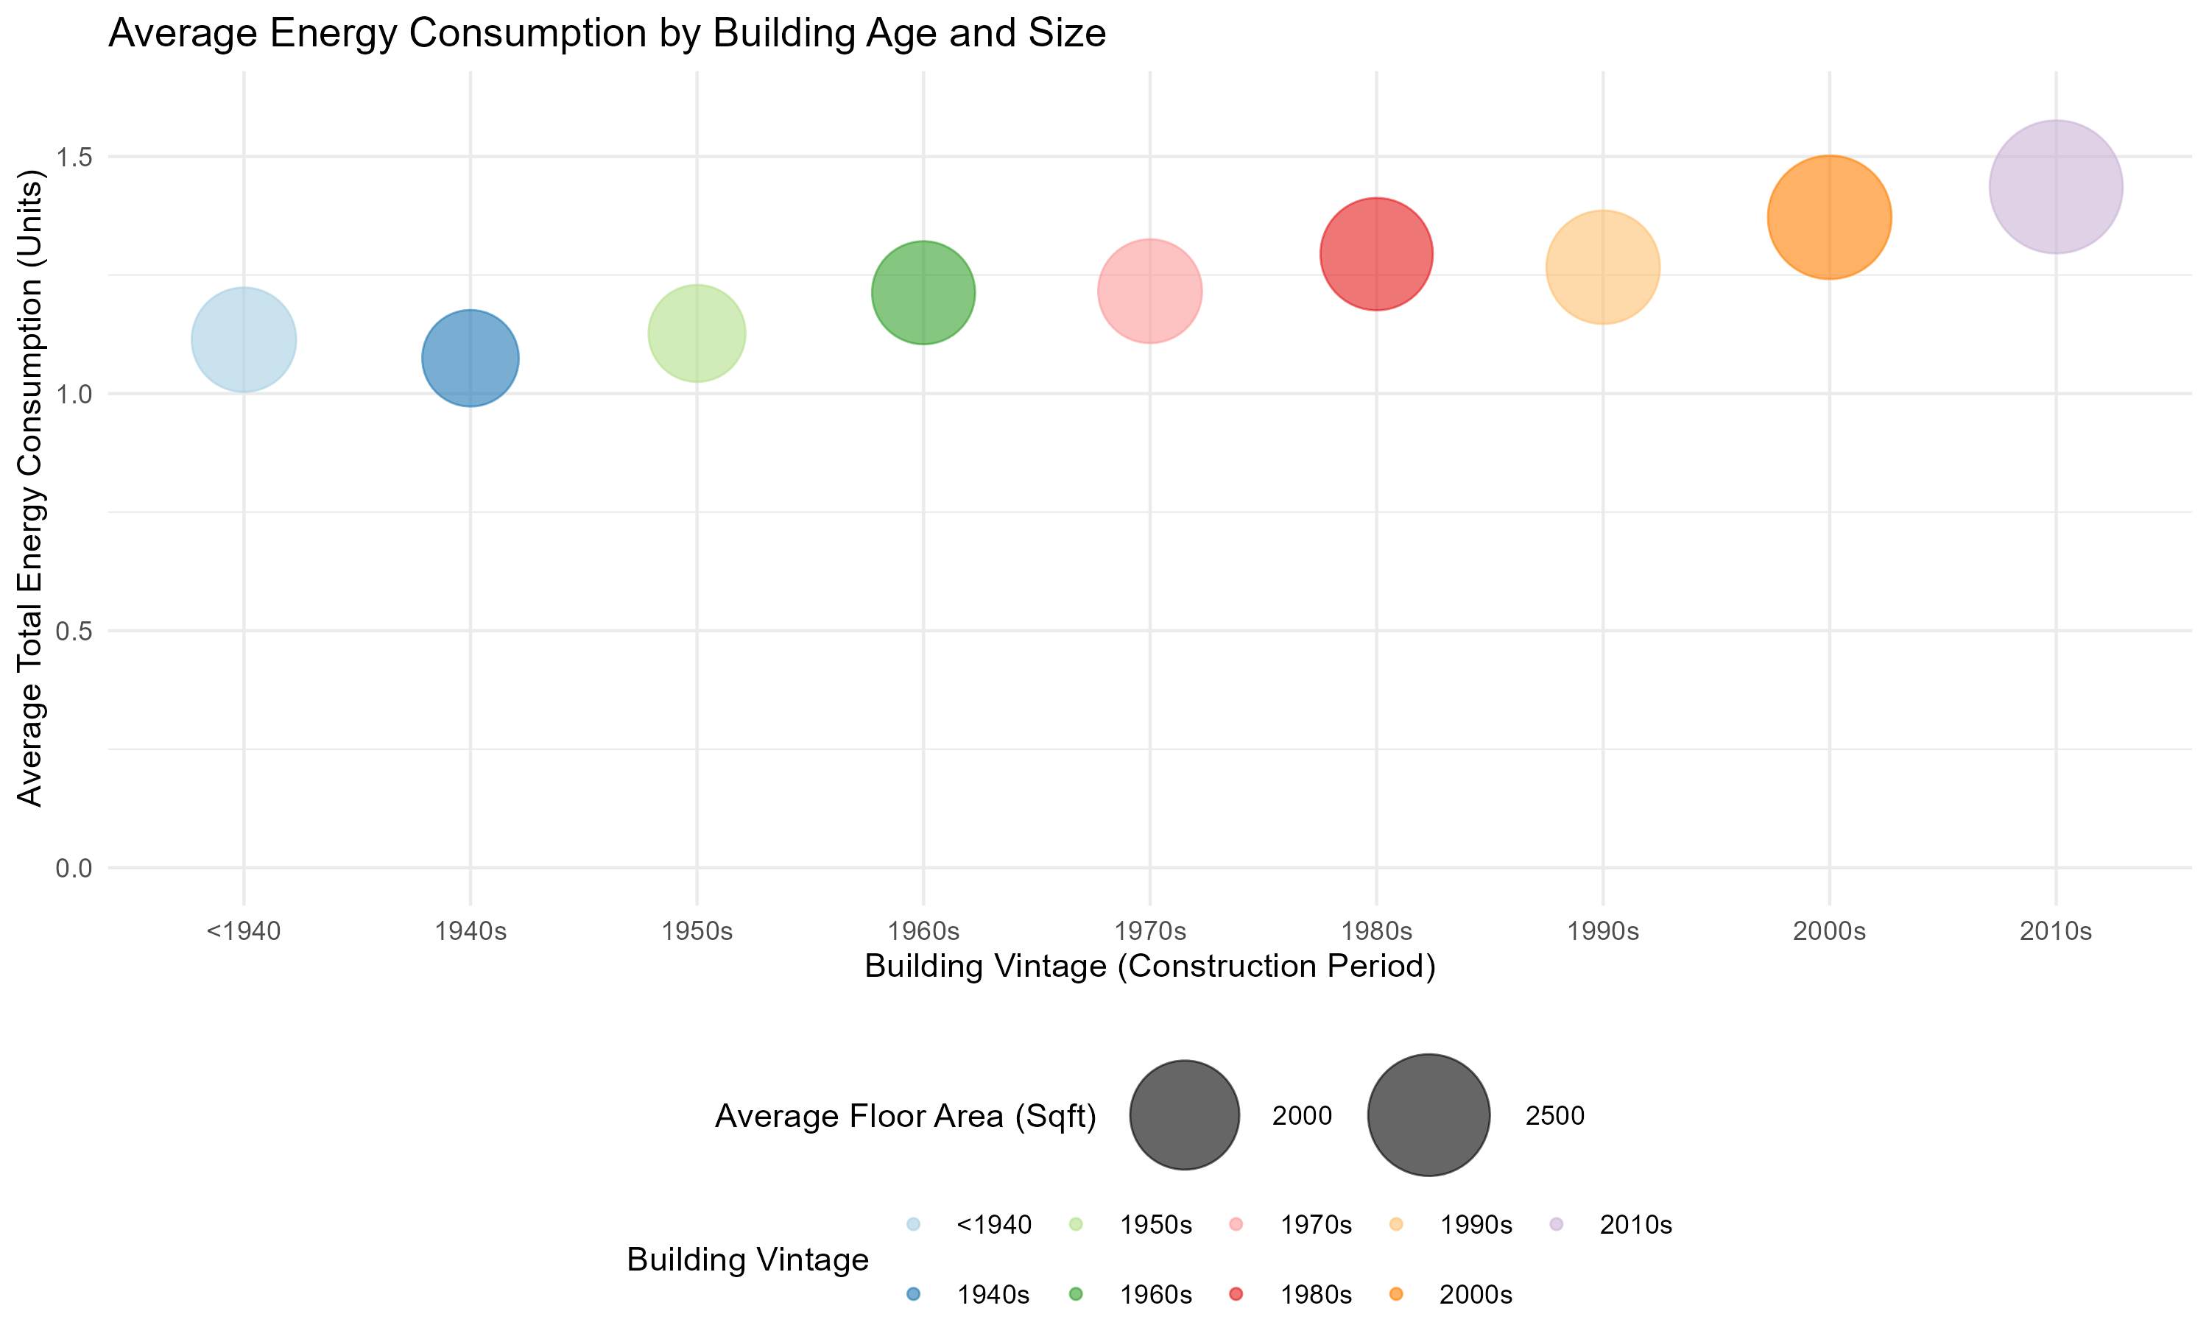
Energy Consumption by Building Age & Size
You can enter a subtitle here if you need it
Notes:
Understanding whether newer or older houses tend to have higher or lower energy efficiency can inform strategies for demand reduction.
Building Retrofits: As energy consumption appears relatively consistent across different building ages, there's an opportunity to retrofit older buildings with modern, energy-efficient technologies. Despite their age, these buildings do not necessarily consume more energy, possibly due to previous upgrades or robust original construction. However, further energy savings might still be achievable.
Target Modern Buildings for Efficiency Improvements: Newer buildings (from the 1990s onwards) show a trend towards increased energy consumption. This could indicate that while these buildings might be equipped with modern amenities that consume more energy, they also have the potential for substantial energy efficiency improvements through smart systems and energy management technologies.
Energy Audits: Conduct energy audits across buildings of all ages to identify specific opportunities for energy savings. Even though the chart shows similar energy usage across vintages, individual buildings may vary greatly in their energy efficiency profiles.
Incentivize Upgrades: Develop incentive programs to encourage building owners to invest in energy efficiency improvements, such as better insulation, energy-efficient windows, and modern HVAC systems.
Educational Campaigns: Launch educational campaigns to raise awareness about the benefits of energy efficiency. This could help overcome the perception that only old buildings benefit from energy upgrades.

Slide 11
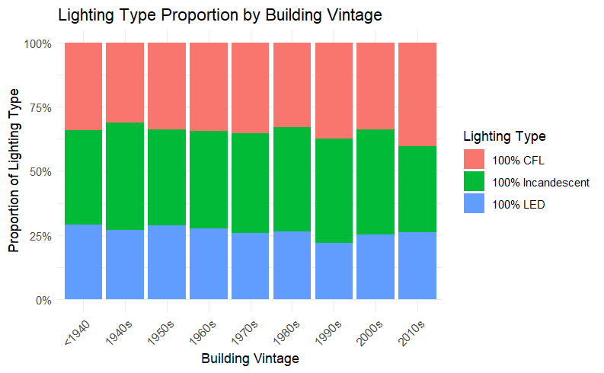
Lighting Type Proportion by Building Vintage
Type | Incandescent | CFL | LED
Watts used | 60W | 14W | 7W
Average cost per bulb | $1 | $2 | $4 or less
Average lifespan (hours) | 1,200 | 8,000 | 25,000
https://viribright.com/blogs/insights/comparing-led-vs-cfl-vs-incandescent-light-bulbs

Slide 12
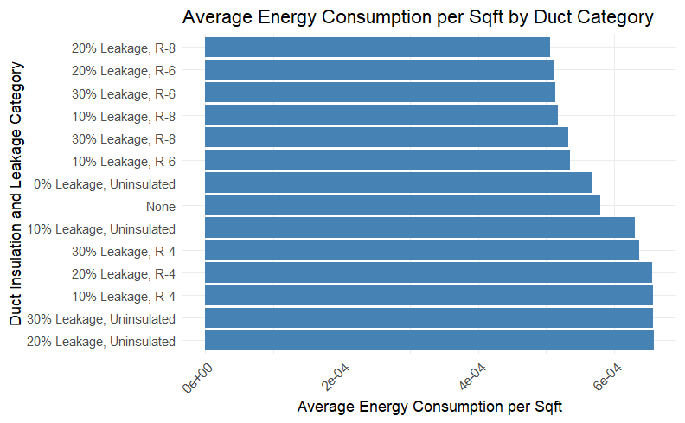
Duct Insulation and Energy Consumption
Notes:
Duct Sealing and Repair: Leakage, especially at the 30% level, contributes to a wide range of energy consumption outcomes. Implementing a duct sealing and repair program could be an effective strategy for reducing energy consumption.
Promote Insulation Upgrades: Even at lower leakage levels, adding insulation (R-4, R-6, R-8) correlates with reduced energy consumption. Promoting insulation upgrades, especially for systems currently uninsulated, could yield significant energy savings.
Educational Campaigns: Use the data to educate consumers about the impact of duct leakage and insulation on their energy bills. Show them how improved ductwork can lead to immediate and long-term savings.
Incentive Programs for Energy Efficiency: Develop incentive programs for both residential and commercial building owners to upgrade their HVAC ductwork. Rebates or tax credits could be used to offset the initial cost of these upgrades.
Energy Audits: Offer energy audits that specifically assess ductwork insulation and leakage. Many consumers may be unaware of the condition of their ducts and the potential savings from proper maintenance and upgrades.

Slide 13
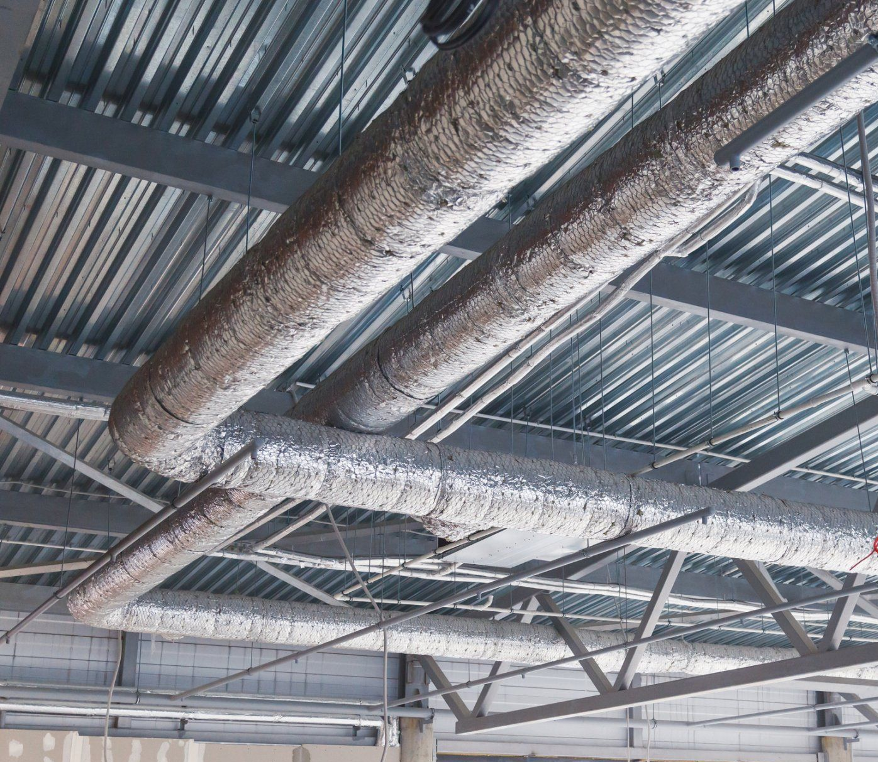
Duct Insulation and Energy Consumption
20% Leakage, Uninsulated
20% Leakage, R-8
Save 11105.62 (kWh)/month
≈0.19%

Slide 14
Conclusion -1/2
Strategic Energy Management
Move beyond building age, focus on performance-based energy management.
Conduct detailed energy audits to pinpoint specific areas of energy loss.
Smart Thermostat Implementation
Promote the use of smart thermostats for real-time energy optimization.
Utilize data for adjusting energy use during off-peak hours and according to occupancy.
Notes:
Strategic Energy Management: Considering the consistent energy use across buildings of various ages, target energy management strategies not just by age but by actual performance. Use detailed energy audits to identify specific energy loss points irrespective of the building's age.
Smart Thermostat Implementation: With the variability in energy consumption by cooling setpoint and time of day, promote the implementation of smart thermostats. These devices can optimize energy use based on real-time data, adjust to off-peak hours, and react to occupancy patterns, thus saving energy more effectively than manual setpoint adjustments.
Targeted Retrofits for HVAC Systems: Leverage the data showing different energy consumptions for various HVAC systems to focus retrofits on the least efficient systems, regardless of the type. Specifically address systems that have higher energy use at peak hours with more efficient technologies, such as variable refrigerant flow (VRF) systems, and promote the retrofitting of ductwork to reduce leakage.
Data-Driven Infrastructure Development: Use regional energy demand profiles to guide infrastructure development. For high-demand regions or times, consider infrastructure that supports demand-side energy generation, like community solar projects, to reduce peak demand stress on the grid.

Slide 15
Conclusion -2/2
Targeted Retrofits for Building Systems
Focus retrofits on the least efficient HVAC systems identified by consumption data.
Upgrade to high-efficiency technologies like VRF systems and improve ductwork to minimize leakage.
Data-Driven Infrastructure Development
Develop infrastructure based on regional energy demand data.
Support demand-side generation with community solar projects to alleviate grid stress during peak times.
Notes:
Strategic Energy Management: Considering the consistent energy use across buildings of various ages, target energy management strategies not just by age but by actual performance. Use detailed energy audits to identify specific energy loss points irrespective of the building's age.
Smart Thermostat Implementation: With the variability in energy consumption by cooling setpoint and time of day, promote the implementation of smart thermostats. These devices can optimize energy use based on real-time data, adjust to off-peak hours, and react to occupancy patterns, thus saving energy more effectively than manual setpoint adjustments.
Targeted Retrofits for HVAC Systems: Leverage the data showing different energy consumptions for various HVAC systems to focus retrofits on the least efficient systems, regardless of the type. Specifically address systems that have higher energy use at peak hours with more efficient technologies, such as variable refrigerant flow (VRF) systems, and promote the retrofitting of ductwork to reduce leakage.
Data-Driven Infrastructure Development: Use regional energy demand profiles to guide infrastructure development. For high-demand regions or times, consider infrastructure that supports demand-side energy generation, like community solar projects, to reduce peak demand stress on the grid.

Slide 16

Thanks!
Do you have any questions?

